Slide 1
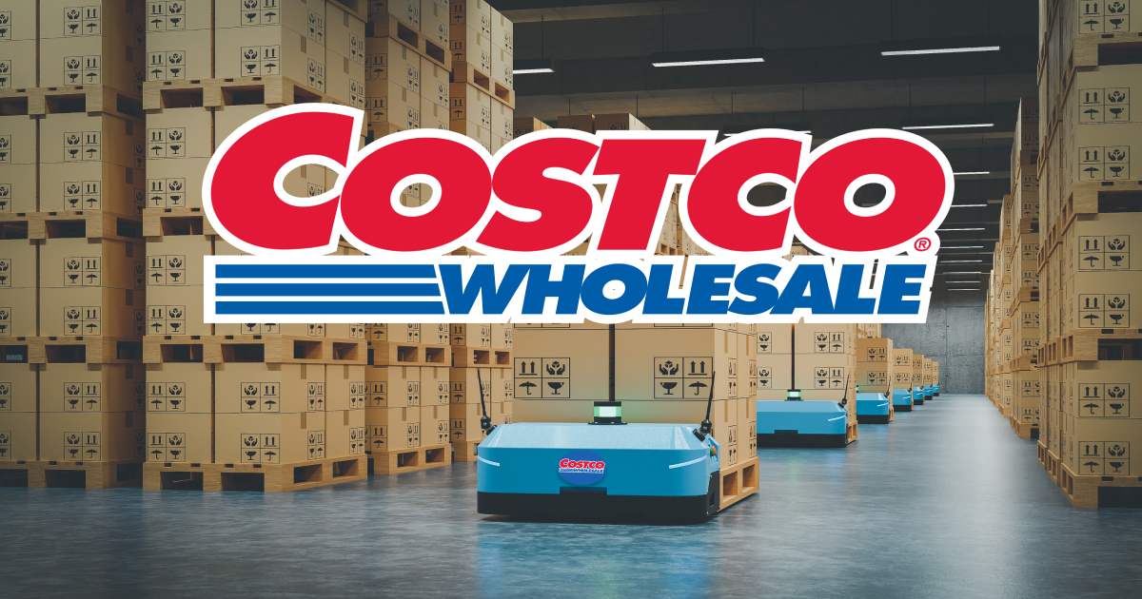


Inventory Forecasting
Business-led Technology Partners Delivering Real Digital Outcomes

Slide 2
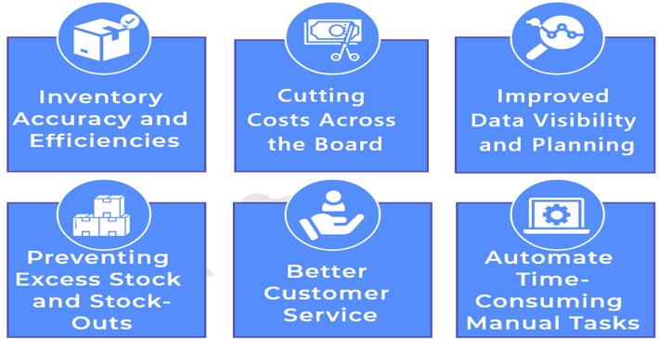
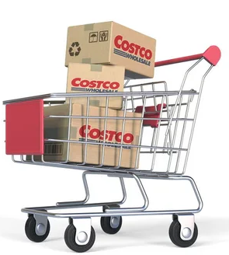
Why Inventory forecasting?

Slide 3
Objective of POC
The current task is to improve the Costco Inventory forecasts for a location & Products.
To improve the Costco Inventory forecasts. ​
In scope data
Sales Shipment Data responding to 1 years of time series data.
Inventory data to weekly granularity.
Forecasting demand to increase their revenue and to continue uninterrupted distribution.

Slide 4

Model Process
EDA
SARIMA & Analysis
Results
Analysis of performance of the curve of SARIMA,
LSTM, Prophet
Exploratory analysis
Trend analysis
Identified boundaries & Product’s patterns
Finalise the results & Modelling strategy
Acceptance critera & POC closure
BRD & Implementation (SDLC)

Slide 5
Executive Summary:
One year of inventory data has been used to generate 3 years of synthetic data by using AI tool.
Pareto’s principle (80/20 rule): This analysis used for identifying which items are most important and which ones require the highest levels of attention.
Analyzing trends and seasonality of product to understand its demand.
SARIMA model used for forecasting based on performance metrics.
Based on 80/20 rule, following locations and Items selected:
Locations: Richmond CA, Fremont, Hayward, Lakewood, San Francisco Bus CTR
Items: Chicken, Drumstick, Fillet and Beef

Slide 6
Data
Synthetic data:
Synthetic data is information that's artificially generated rather than produced by real-world events.
We have used one year of inventory data and generated 3 years of synthetic inventory data by using AI tool.
Data generation by using gretel.ai tool.
Data generated for the duration of Jan-2020 to Nov-2022.

Slide 7
Calculations:
For a given location & date stock is calculated using below formula.
Stocks = D(LT) - Onhand - InTrn(LT) + PndSales(LT)
Where,
D(LT) – The demand forecast.
On Hand- The available quantity.
InTrn(LT) – The in-transition quantity that should arrive.
PndSales(LT) – The pending sales orders quantity that should be shipped to customers.

Slide 8
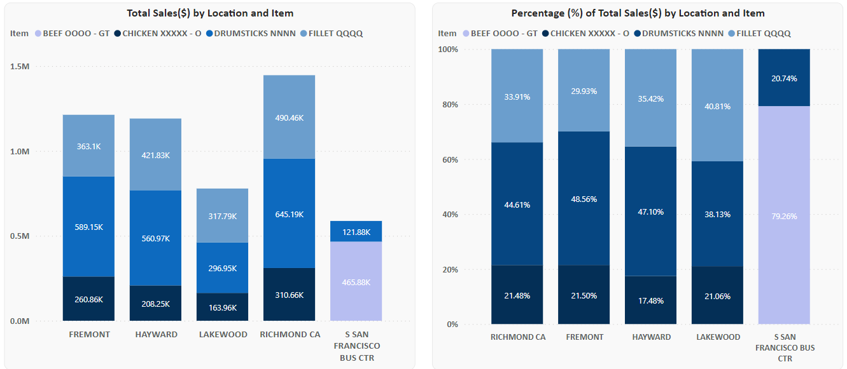
Sales Overview:

Slide 9
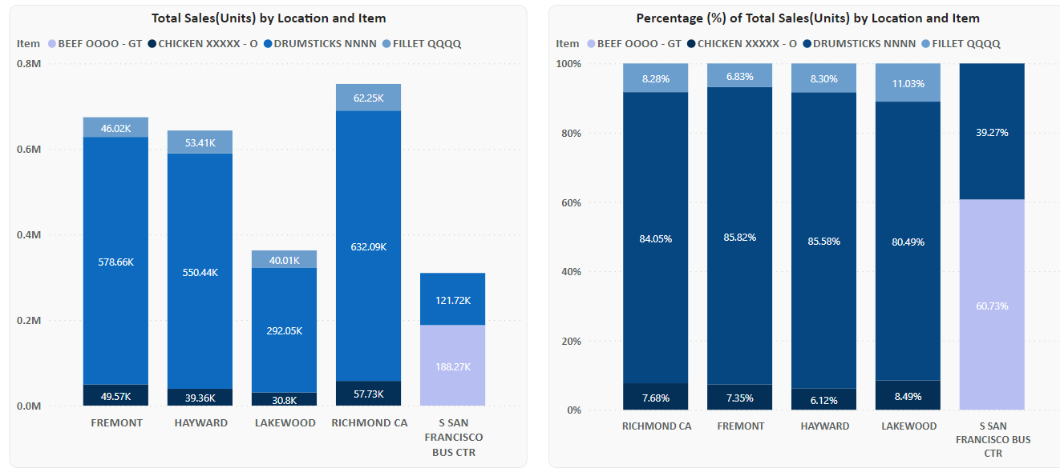
Quantity Overview:

Slide 10
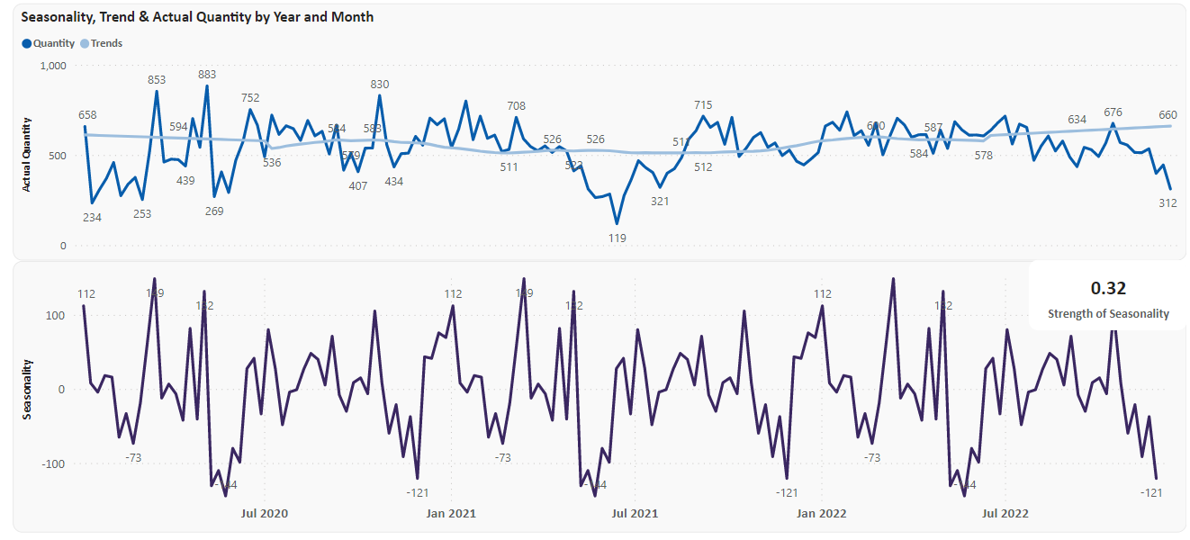
Trends and Seasonality:
Location: Hayward, Item: Drumstick

Slide 11
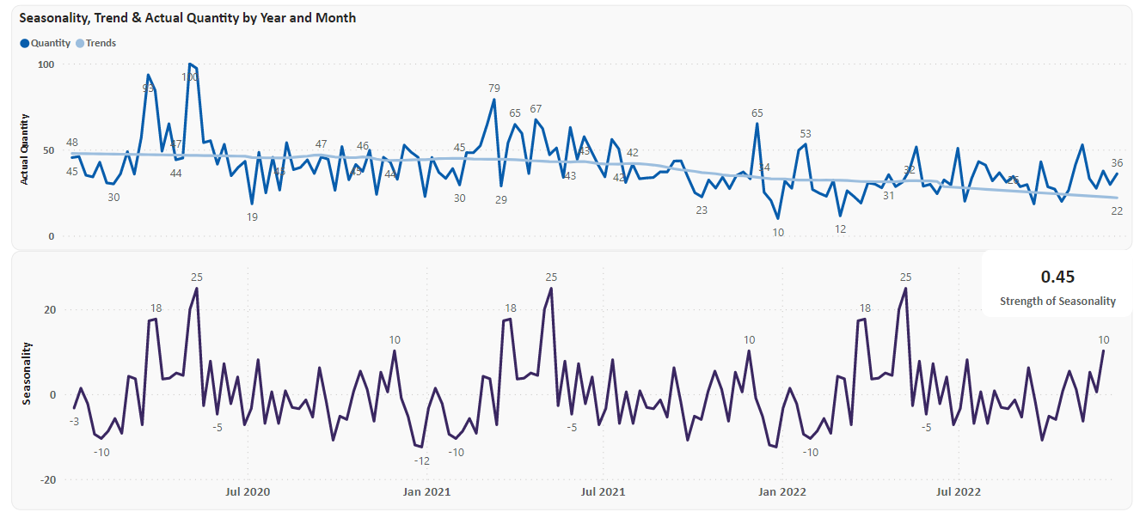
Trends and Seasonality:
Location: Lakewood, Item: Chicken

Slide 12
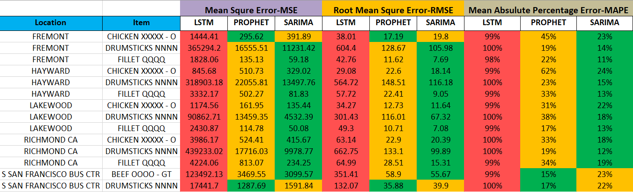
Forecasting Matrices:

Slide 13
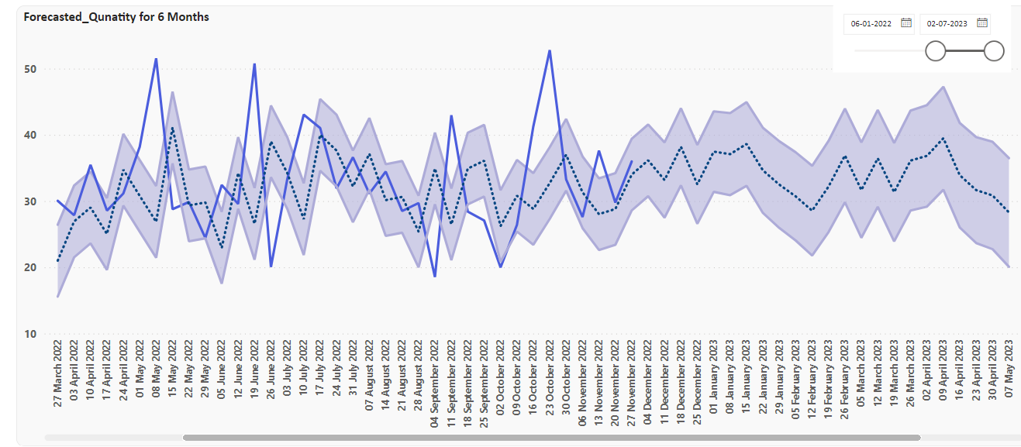
Forecasting:
Location: Lakewood, Item: Chicken
Blue Line: Actual_Qty
Dotted Line: Forecasted_Qty
MSE:135.44, RMSE: 11.64, MAPE: 22%

Slide 14
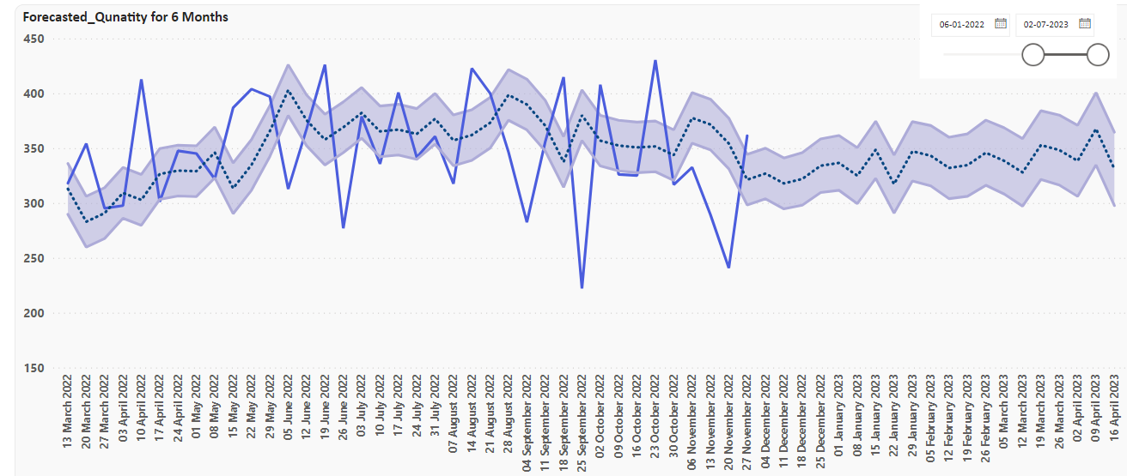
Forecasting:
Location: SAN FRANCISCO, Item: Beef
Blue Line: Actual_Qty
Dotted Line: Forecasted_Qty
MSE:3099.57, RMSE: 55.67, MAPE: 23%

Slide 15
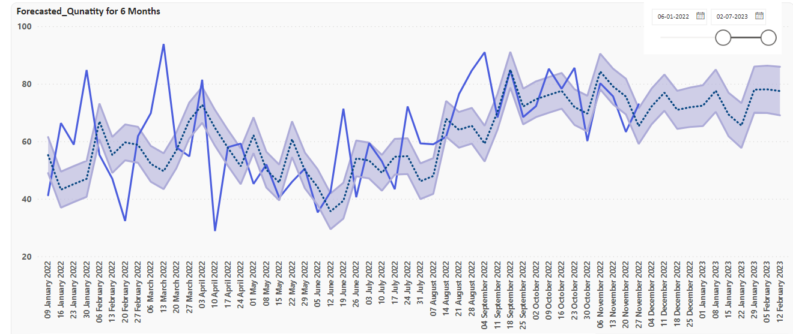
Forecasting:
Location: Richmond CA, Item: Fillet
Blue Line: Actual_Qty
Dotted Line: Forecasted_Qty
MSE:234.25, RMSE: 15.31, MAPE: 19%

Slide 16
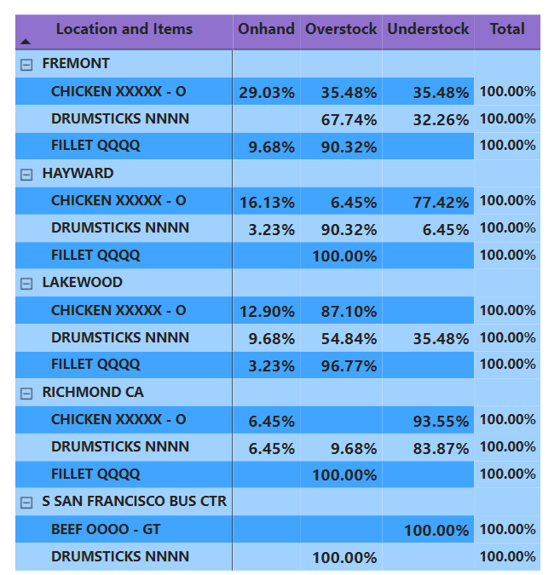
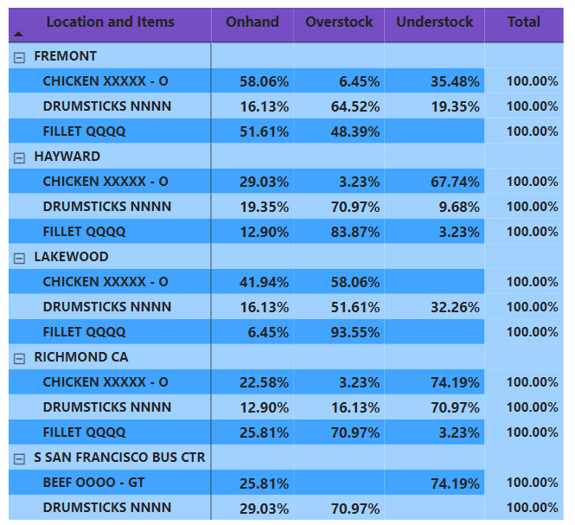
Stock Analysis (May-Nov 2022):
Actual Data
Forecasted Data

Slide 17
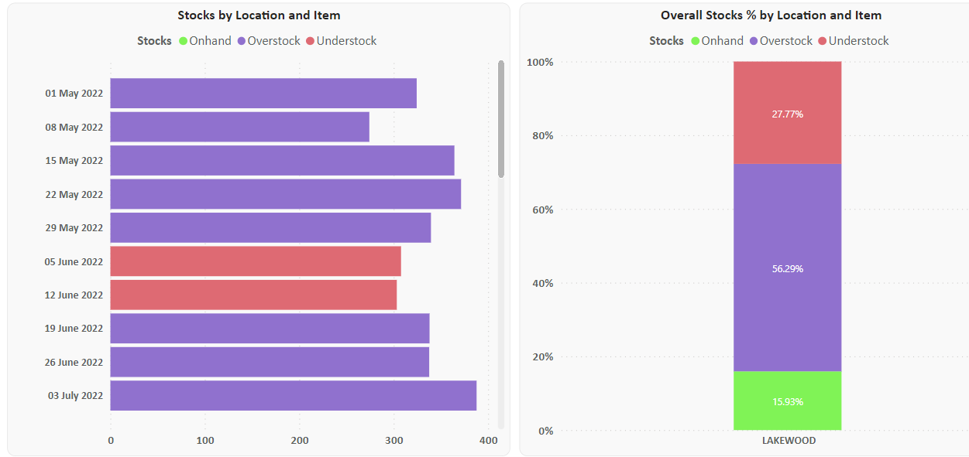
Weekly Onhand, Overstock and Understock cases: (May-Nov 2022)
Location: Lakewood, Item: Drumstick

Slide 18
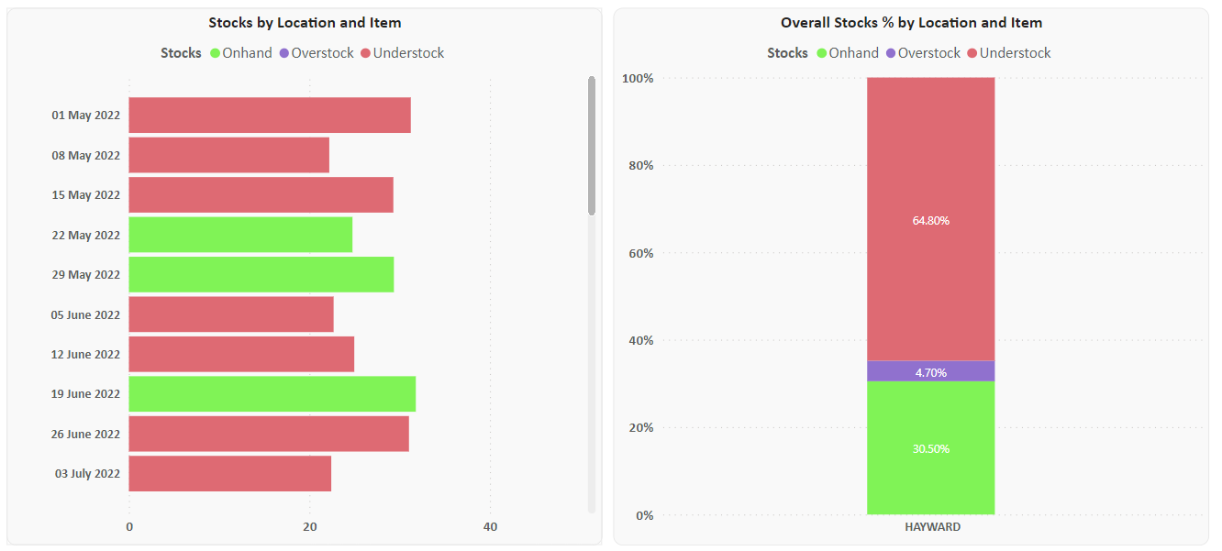
Weekly Onhand, Overstock and Understock cases: (May-Nov 2022)
Location: Hayward, Item: Chicken

Slide 19





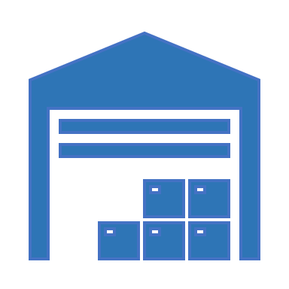



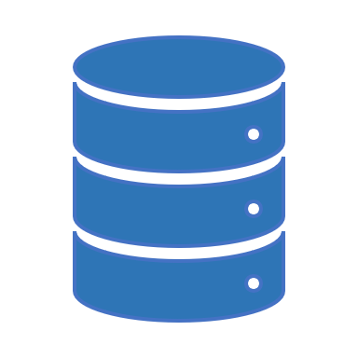


Data Driven Framework: Control Tower View
Efficient Promotional Planning
Plan Production
Sales Trend & Tracking
Optimize Inventory
Costco SME
Reduced
Transportation Costs
Monitor Key KPIs
Re-calibration
&
Monitoring
Re-Training
&
Updates
Customer
Segmentation
Demand
Forecasting
Volume & Monetary
Promotional lift
Regularity & Recency
SKUs
Promotions
Distributors
Market Response
Data Driven Predictive Framework

Slide 20
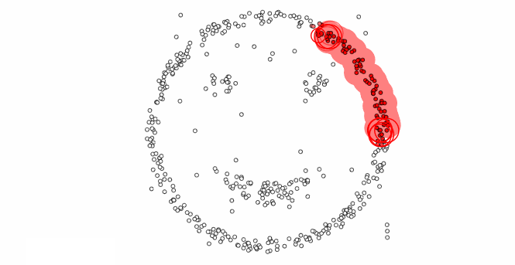
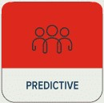
Customer/ Distributors Segmentation
Clustering
Segmentation further enriches marketing and promotional activities to resonate with specific customers.
Customer Segmentation enables profiling customers on common characteristic's such as portfolio profiling, purchase patterns, etc.
Strategizing
Diminishing
$400k
#103 Customers
Champions
$24 M
#24 Customers
Customer Value
Patterns / Regional in-insights that emerge out of clustering technique further help in designing a forecasting model
Inactive
$100k
#73 Customers
High Value
$9.5 M
#58 Customers
Profiling
*Numbers are for Illustrations
Potential Value

Slide 21




Benefits of using Promotion based forecasting @
Warehouse Level
Distributors (Suppliers)
Distributor Insights
Simulations & SME interactions
Price Strategy
Less understocking
Optimal Sell through rate during over stocking time segments
Reduced Inter-Warehouse Shipment
Best segments for initiating specific promotions
Customized Forecast Model
Trend and Regularity Insights
Costco
SME
Safety stock suggestions w.r.t
Churn possibilities and Idle customers at any given point of time
Promotional effectiveness
Ceiling recommendations in discounts based on price elasticity demand
Baseline discount threshold for maintaining trend
Data Driven
Simulations &
SME interactions
Data driven production planning
Stock Simulation using flexi parameters for SME
New acquisitions : Sales target
Forecasting simulations for different types of promotions
Price per quantity discount
Lumpsum discount
Coupons
Inventory
Management

Slide 22
Thank You

Slide 23

Appendix

Slide 24
Our Power BI Credentials
One of the leading Power BI Partner globally
Trained 4,000+ users globally through 100+ events
Implemented Power BI Premium at several large enterprises
Key focus on 3 A’s: Adoption, Agility & Actionable
Helped create data culture at several organizations
A strong team of Power BI evangelists & consultants with proven expertise

Slide 25



About iLink
iLink Systems delivers next-generation technology solutions to help clients solve complex business challenges, increase business productivity, realize sustainable enterprise value and transform their businesses inside-out
Company Overview
Locations
Focus Area
Founded in 2002
Global Software Solution Provider
Trusted Digital Advisor
Innovation Focused
ISO 9001 & CMMI Level 3 Certified
Gold Certified Microsoft Partner
Nationally Managed Microsoft Partner
Won 4 Partner of the Year Awards
~700 people global team
Seattle, WA (HQ)
Los Angeles & Irvine, CA
Fairfax, VA
Atlanta, GA
Dallas & Houston, TX
Chicago, IL
New Jersey, NJ
Chennai, Pune & Trichy, India
Dubai
Product Development
App Modernization
Cloud Platform
Data Platform
Business Analytics
Artificial Intelligence
Internet of Things (IoT)
QA Automation
DevOps
Telecom
Healthcare
Life Sciences
ISV
Oil & Gas
Chemical
Financial Services
Retail
Manufacturing
Consumer Goods
Business-led Technology Partners Delivering Real Digital Outcomes

Slide 26







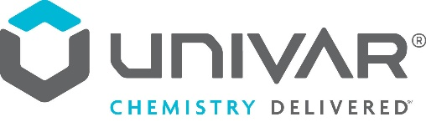

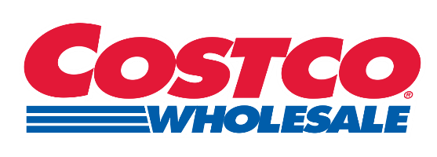




















Our Customer Portfolio

Slide 27
Why iLink?
Helped create data culture at several organizations
Implemented Cloud Data Warehouses & Data Lakes in several large enterprises
Implemented Modern Cloud BI in several large enterprises
Big enough to deliver & small enough to care
A strong team of data & analytics consultants with proven expertise
Very flexible engagement models that fits best for our customer needs

